Slide 1
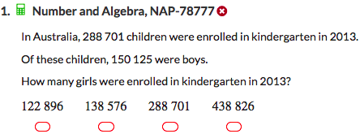
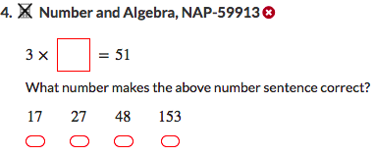
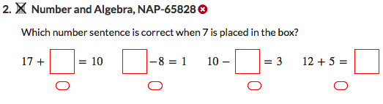
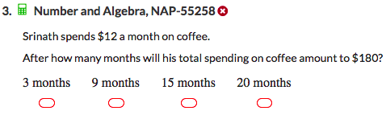
NAPLAN Starter Questions

Slide 2





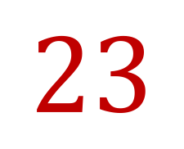

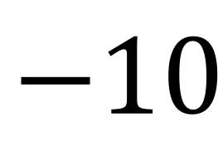
My Numbers and Operations Interactive Notebook
$$+$$
$$23$$
-1
$$−$$
$$×$$
$$÷$$
Name:
Class:
Teacher:
Semester 1
Term 1
$$5^{2}$$
$$0$$
$$−10$$

Slide 3

Interactive Notebooks!
Cover Page
Contents Page
Glossary
24/7/30
EQ
Questions
Notes
Summaries
Work page
Presentation!!!
Your book, your responsibility!

Slide 4


Slide 5
Contents
Glossary or Formula Page
Page
Date
Description
2
3

Slide 6

Learning Intentions
To learn a bit about the history of number systems
To further expand and solidify our mathematical vocabulary
To further learn the value of the place system
To compare, order, add and subtract integers
WICOR

Slide 7
24
7
30
Number systems
Date
EQ – What are some examples of different number systems and which one do we use?
Think-Pair-Share:
Find a partner and consider the following questions:
What are some characteristics of the number system you use every day?
(what digits is it made up of? Why might that be?)
What are some other possible number systems we use everyday?
Be prepared to share your ideas with as part of a class brainstorm
Hint: How do they measure height in the United States? What are some of the intervals of time? What two numbers are used in computing? What are some of the properties of circles?
Summary:

Slide 8
https://www.youtube.com/watch?v=cZH0YnFpjwU

Slide 9
24
7
30
Number Systems
Date
EQ – What are some examples of different number systems and which one do we use?
In everyday life, people use base 12, base 2 and base 60 to measure everything from time to length, and to program our electronic devices. Mainly, though, base 10 is used. In some cultures, though, numbers weren’t used at all!
Ex:
Some Aboriginal people used words as their base for counting. The Belyando River people of central Queensland used only two words:
1 = wogin
2 = boolerooo
3 = booleroo wogin
4 = booleroo booleroo
5 = ??? – Can you figure out the word for 5? How about for 6 and 7 as well?

Slide 10
24
7
30
Number Systems
Date
EQ – What are some examples of different number systems and which one do we use?
Ex 2:
The Kamilaroi people lived in Northern New South Wales and used three words in their counting system:
1 = mal
2 = bularr
3 = guliba
4 = bularr bularr
5 = bularr guliba
6 = guliba guliba
7 = ??? – Can you figure out the word for 7? How about for 8 and 9 as well?
This isn’t to say Aboriginal people didn’t use numbers...

Slide 11
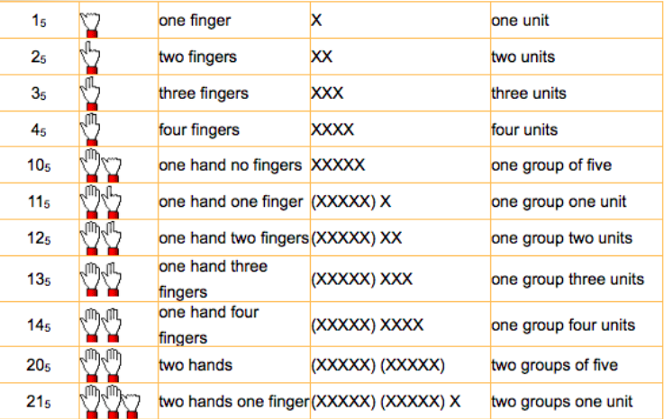
24
7
30
Number Systems
Date
EQ – What are some examples of different number systems and which one do we use?
Many Aboriginal people, including those here in Western Australia, used a base 5
system, where the only digits are 0,1,2,3,4
This system can be thought of in terms of money: we swap 5 $1 coins for a $5 note
Looking at the 3 examples we’ve seen:
what are some differences?
Why might smaller numbers only have been needed?
Could we use these systems today? Why/Why not?

Slide 12
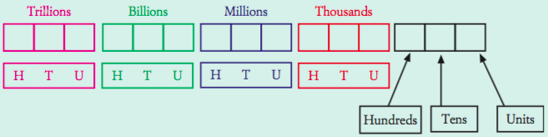
24
7
30
Number Systems
Date
EQ – What are some examples of different number systems and which one do we use?
As mentioned before, we primarily use the Hindu-Arabic base 10 system, that uses the following 10 digits: 0,1,2,3,4,5,6,7,8,9. These digits can be combined to create numbers both large and small, using the place value system.
Place value system – The place in which you write a digit affects its value. The larger place values are on the left and each place is 10 times as big as the one before it.
Each group of three numbers is a ‘house’. Inside each house the numbers go from one to nine hundred and ninetey-nine

Slide 13


Slide 14
24
7
30
Number Systems
Date
EQ – What are some examples of different number systems and which one do we use?
Ex 1:
Write the value of each of the digits in 5316.
Solution:
Look at the place value of each digit in 5316.
6 has a value of 6 or 6 x 1
1 has a value of 10 or 1 x 10
3 has a value of 300 or 3 x 100
5 has a value of 5000 or 5 x 1000
Ex 2:
Write each of these numbers in extended form
a) 247 b) 3587
In 247, the 2 = 200, 4 = 40 and 7 = 7
247 = (2 x 100) + (4 x 10) + (7 x 1)
= 2 x 100 + 4 x 10 + 7 x 1
b) 3587 = (3 x 1000) + (5 x 100) + (8 x 10) + (7 x 1)
= 3 x 1000 + 5 x 100 + 8 x 10 + 7 x 1

Slide 15
24
7
30
Number Systems
Date
EQ – What are some examples of different number systems and which one do we use?
Complete your Summary!!!
Summary:

Slide 16

Do you understand? Fists of Five
Notes:
Check for Understanding

Slide 17
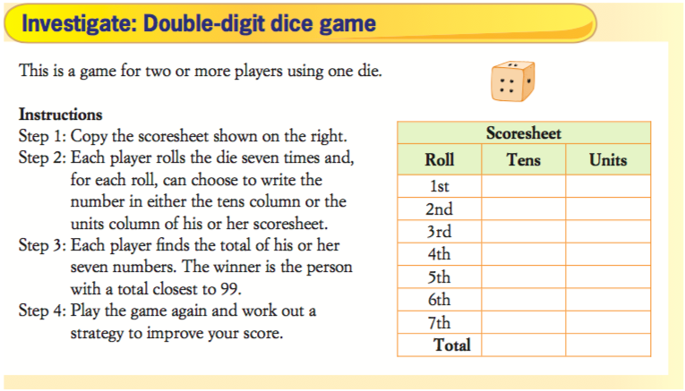

Slide 18
Nelson – Whole Numbers 2
Worksheet for homework

Slide 19
Notes Review
24, 7 ,30
Date
Title
Essential question
Notes complete
Notes complete with colour and diagrams
Questions completed
Contents page filled in
Formula page filled in

